Slide 1
Flash Settings in CCS 9.2.0

Slide 2

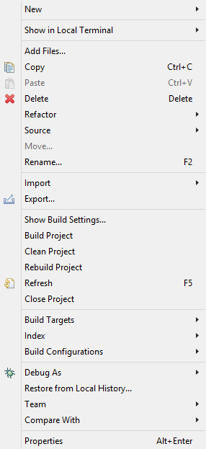
In Workspace right click on the project file and select the Properties
Proj_lab01[Active – Release] -> Properties

Slide 3
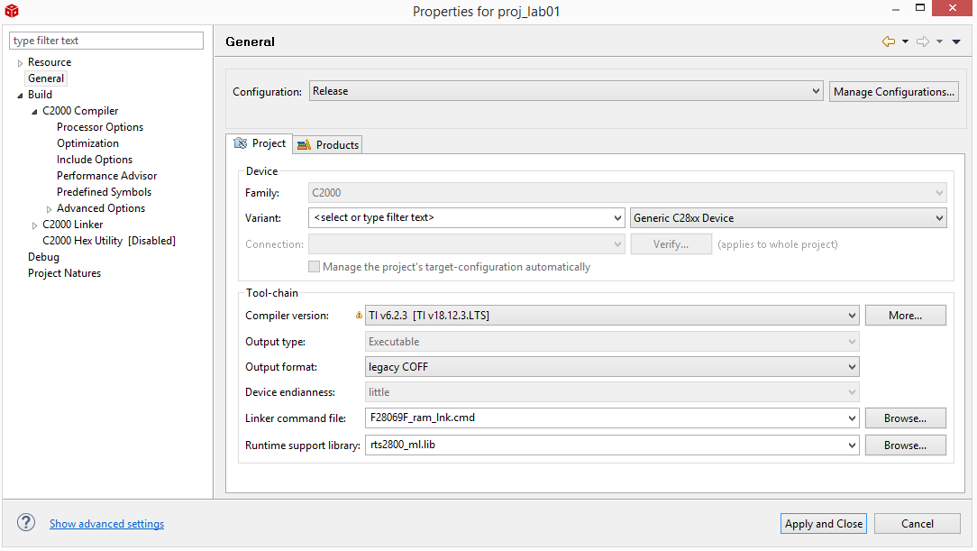
In Properties window select the option General and in that select Manage configuration to add the Flash setting.

Slide 4
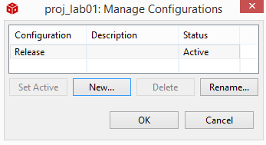
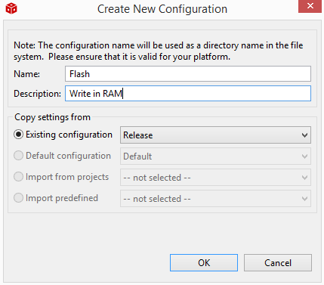
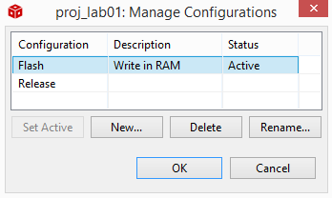
In Configuration Window Select New to Create New Configuration
In Create New Configuration, Add the Name and Description for reference when build the project
1
Once New configuration is Created the Manage Configuration Window will be Updated and Active.
2
3

Slide 5

In Linker Command File add Linker Command File For F28069 Device.
TI\Motorware\motorware_1_01_00_18\sw\ide\ccs\cmd\f2806x

Slide 6
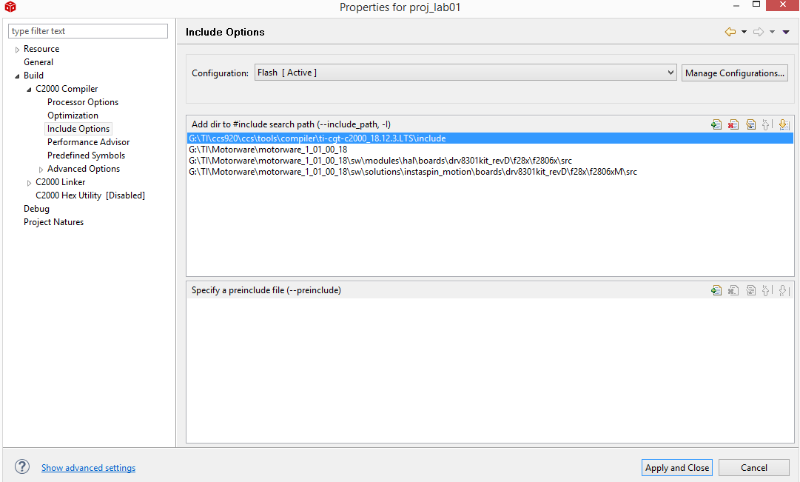
In Include Option add all the files that are needed to build the project.

Slide 7
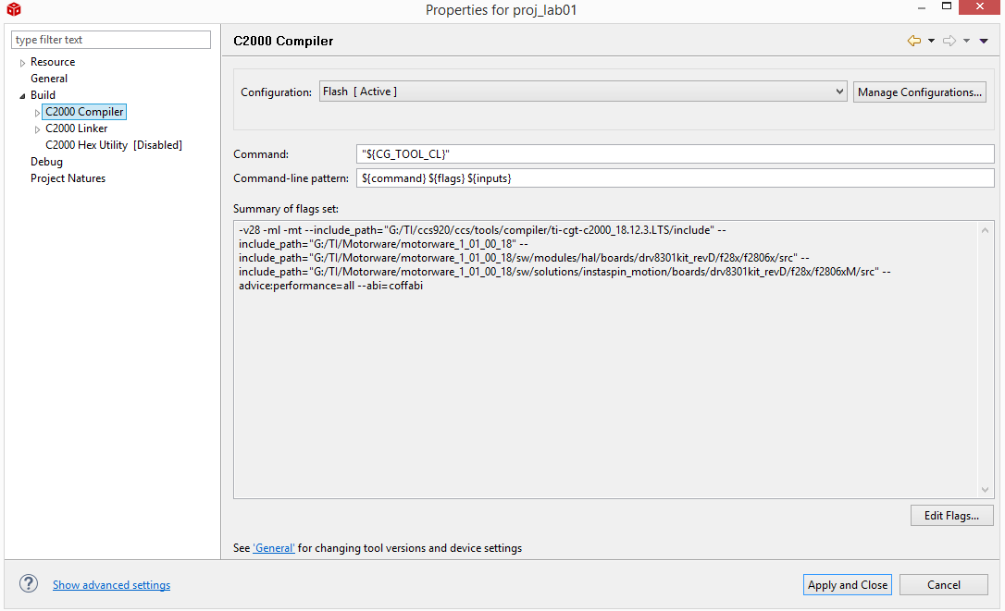
Check whether all the Include files are added.

Slide 8
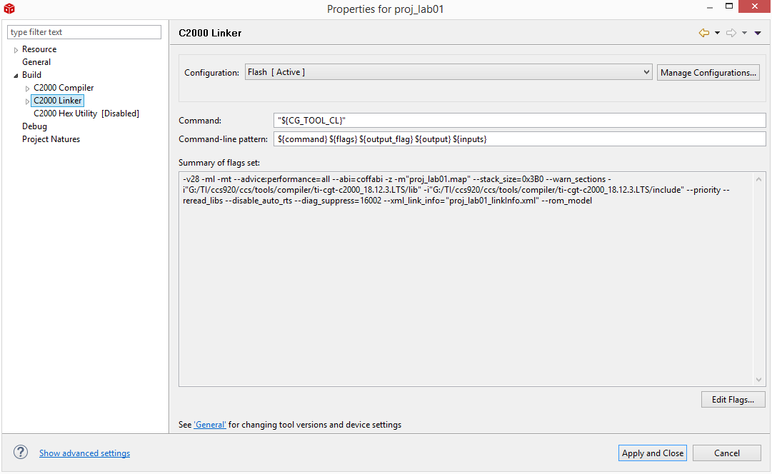
Add the following flags set in the C2000 Linker and then Apply and Close.
-m"${ProjName}.map" --stack_size=0x3B0 --warn_sections -i"${CG_TOOL_ROOT}/lib" -i"${CG_TOOL_ROOT}/include" --priority --reread_libs --disable_auto_rts --diag_suppress=16002 --xml_link_info="${ProjName}_linkInfo.xml" --rom_model

Slide 9
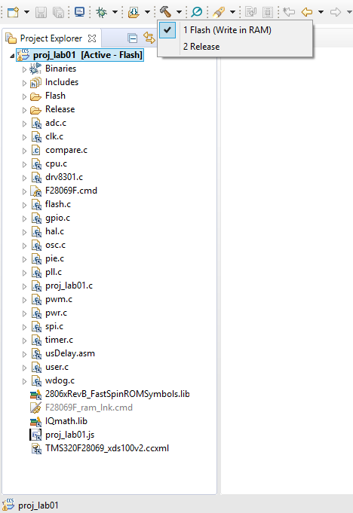
Check in the workspace for RAM/FLASH file added in the project

